Slide 1

Predicting Animal Class Based on Physical and Behavioral Traits
Michal Kuderski and John Gomez
STAT 437 Final Project

Slide 2
Purpose
The objective of this exploratory analysis is to:
Can we determine an animal's classification (mammal, bird, reptile, etc.) based on its physical characteristics and behavioral traits?
Identify patterns in the data that may help us better understand our multinomial logistic regression model

Slide 3
Data Description
Dataset Overview:
101 animals
16 predictors (mostly binary, one numeric)
Response variable: class_type (7 categories)
Important Notes:
Most predictors are binary (e.g., hair, feathers, eggs).
Legs is the only numeric predictor
Class imbalance present (Mammals most frequent).

Slide 4
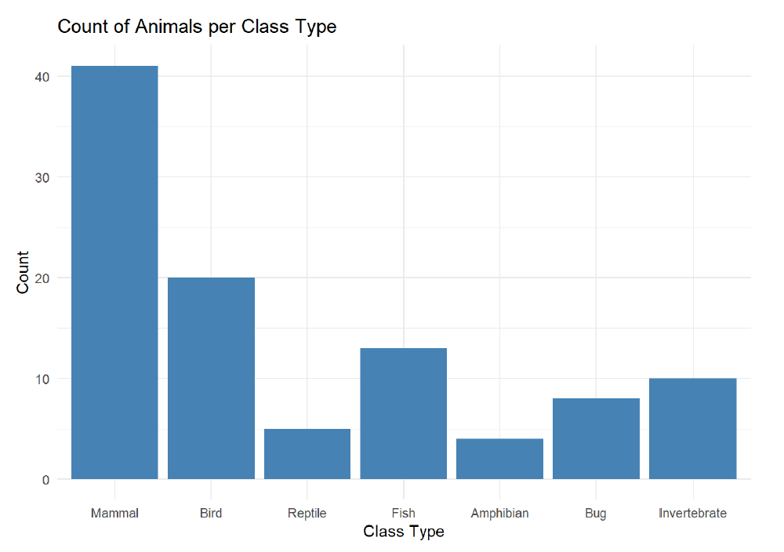
Exploratory Analysis – Distribution
Bar Chart:
  Counts of animals per class
  Mammals and Birds dominate
  Reptiles and Amphibians are the rarest

Slide 5
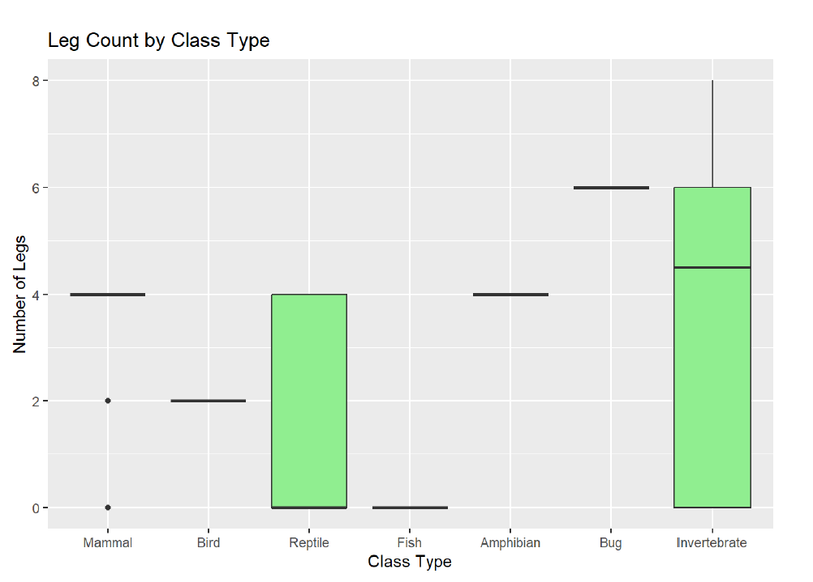
Exploratory Analysis – Distribution
Boxplot:
  Number of legs by class type
  Most classes show consistent leg counts
  Reptiles and Invertebrates have more variation

Slide 6
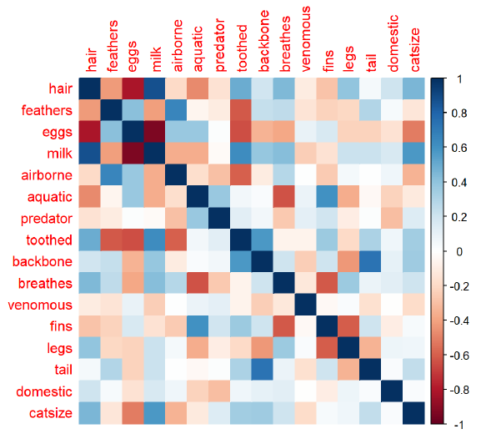
Exploratory Analysis – Relationships
Correlation Heatmap:
  Positive correlations: hair and milk
  Negative correlations: hair and feathers
  Watch for multicollinearity (high correlations > 0.8)

Slide 7

Exploratory Analysis – Relationships
Binary Feature Distributions:
  Bar plots for traits like hair, milk, eggs across class types

Slide 8
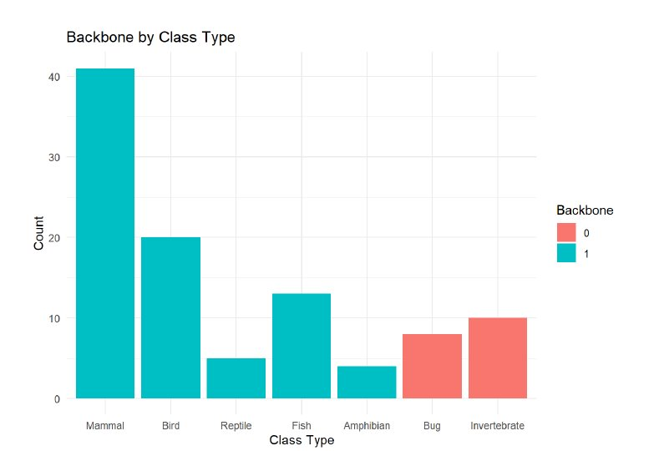
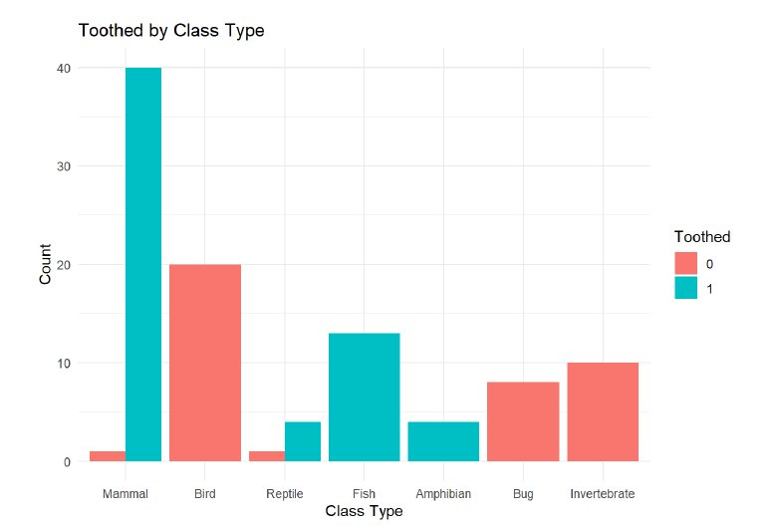
Toothed vs Backbone

Slide 9
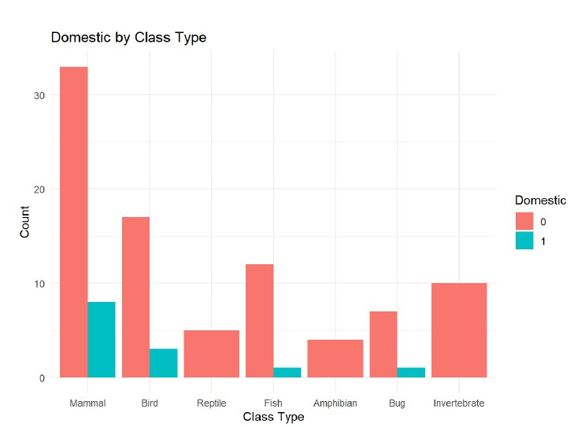
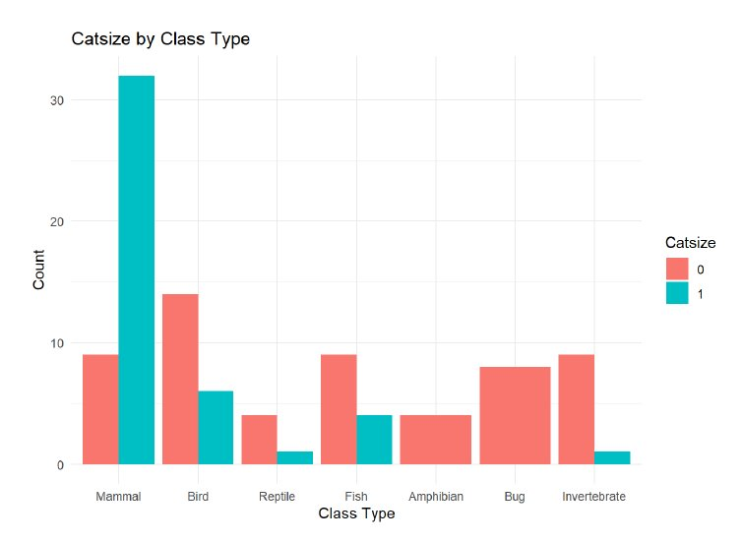
Domestic vs Cat Size

Slide 10
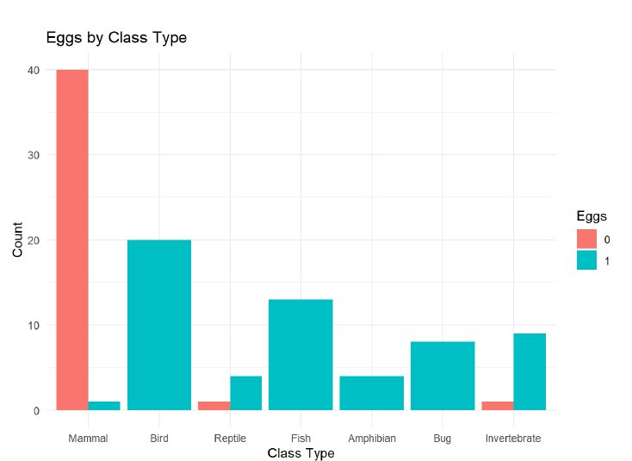
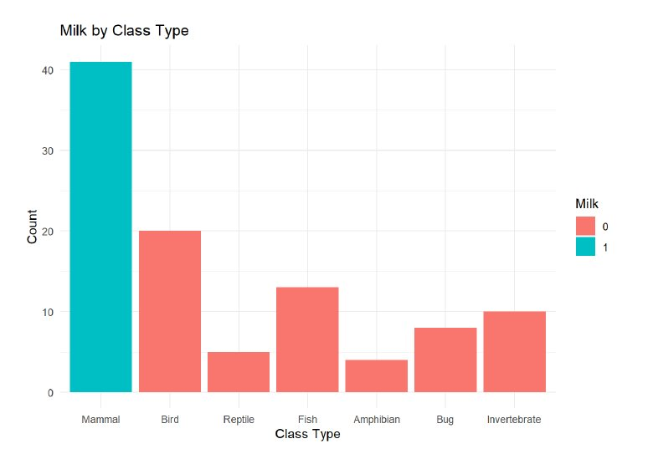
Eggs vs Milk

Slide 11
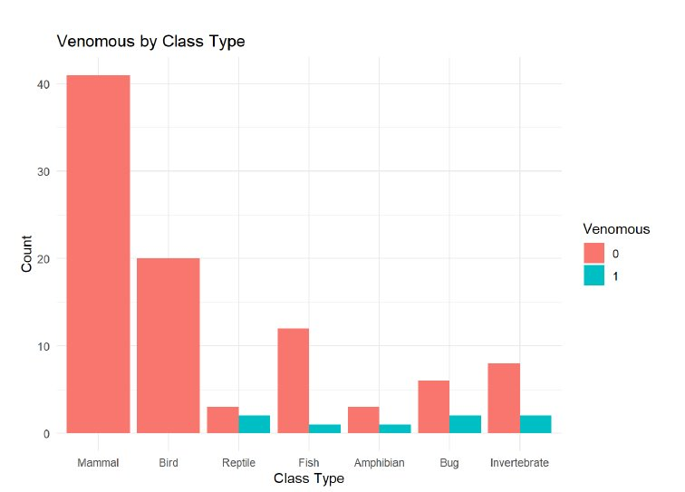
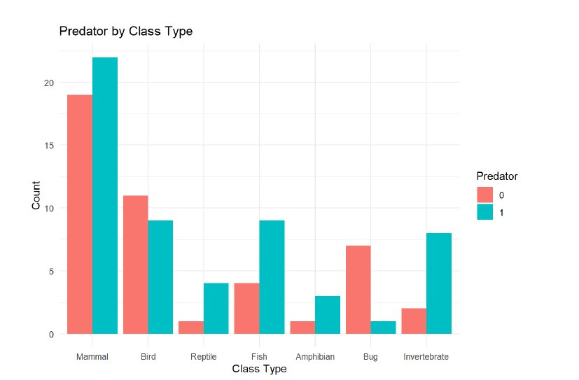
Venomous vs Predator

Slide 12
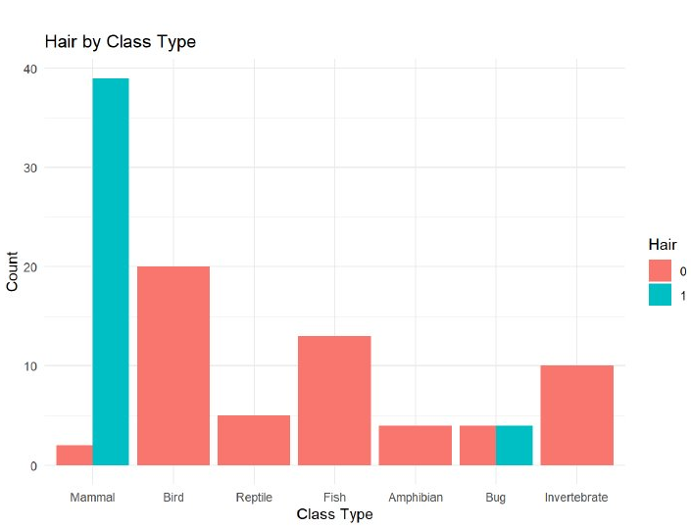
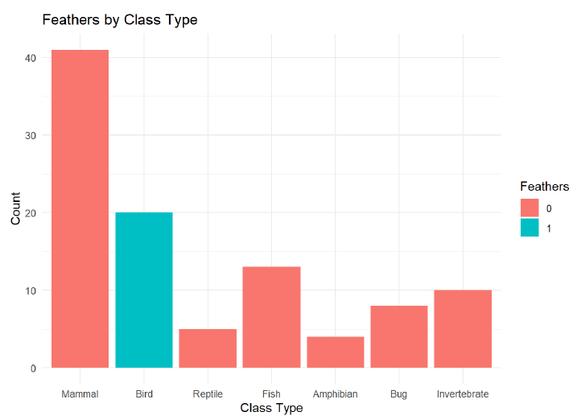
Hair vs Feathers

Slide 13
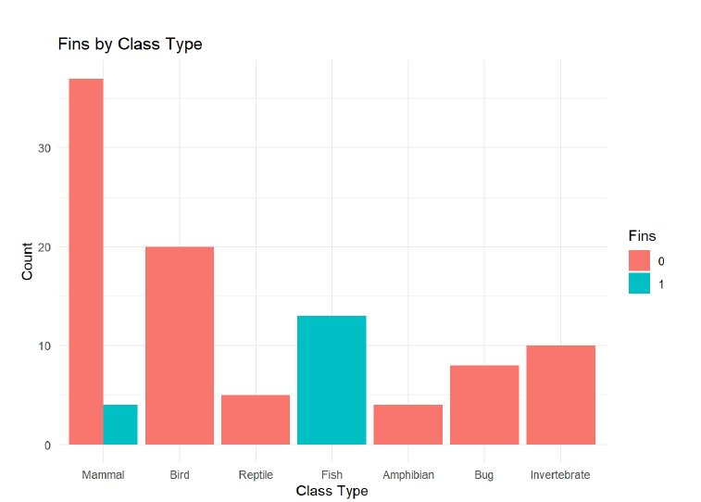
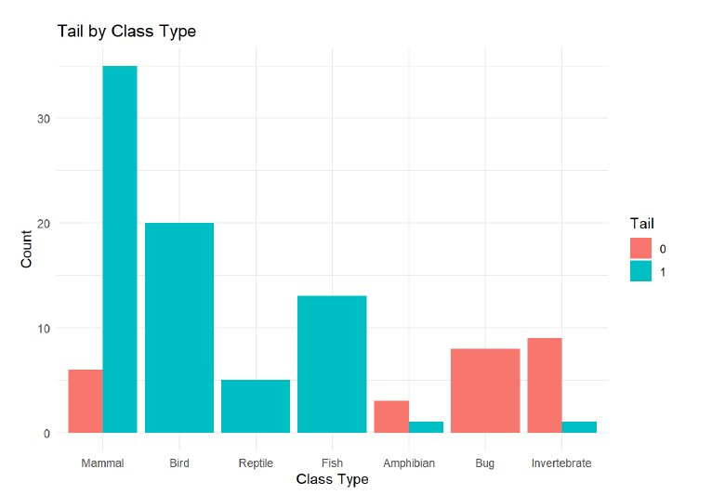
Tail vs Fins

Slide 14
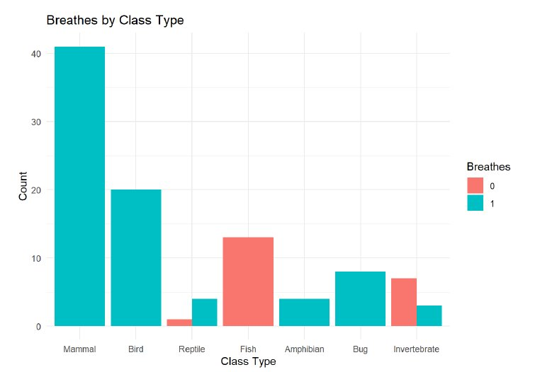
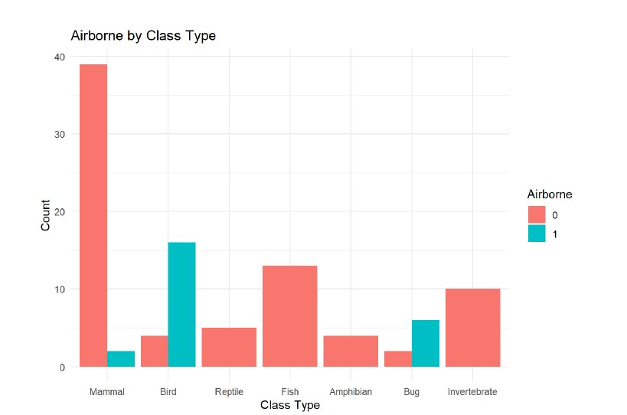
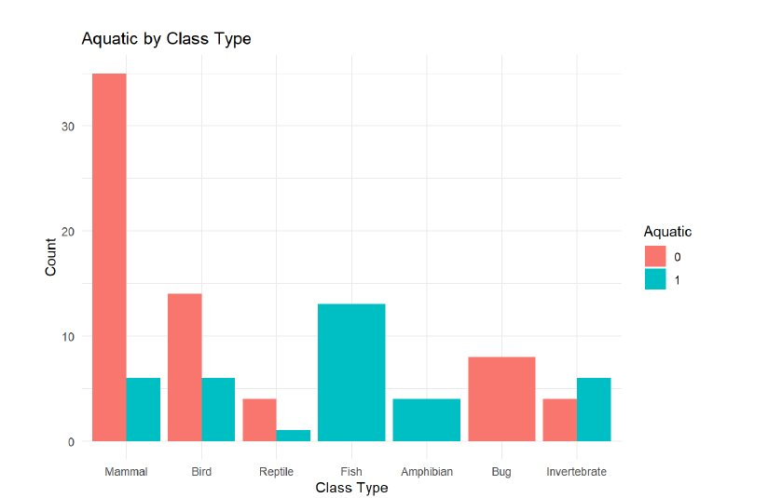
Airborne vs Aquatic vs Breathes

Slide 15
Multinomial Logistic Regression Model
Model:
Predict class_type using selected predictors
Interpretation:
Coefficients show association between traits and class membership
Categorical predictors handled directly

Slide 16
Model Selection
Process:
Predictors selected based on biological relevance and correlation analysis
Checked and avoided strong multicollinearity among predictors
Final Model:
Included key predictors with clear associations to animal classes
Focused on maintaining interpretability and practical meaning
Stepwise selection was considered but not implemented

Slide 17
Model Results Overview
Predictor | Strongest Associated Class | Interpretation
Feathers | Bird | Increases odds of being a bird
Milk | Mammal | Increases odds of being a mammal
Fins | Fish | Increases odds of being a fish
Breathes | Mammal | Trait common among mammals
Venomous | Reptile/Bug | Increases odds of being a reptile or bug
Multinomial logistic regression fitted using biologically relevant predictors
Strong, logical associations between traits and animal classes:
  Feathers → strongly predict classification as Bird
  Milk → strongly predicts classification as Mammal
  Fins → strongly predict classification as Fish
Model AIC: 204.0001.

Slide 18
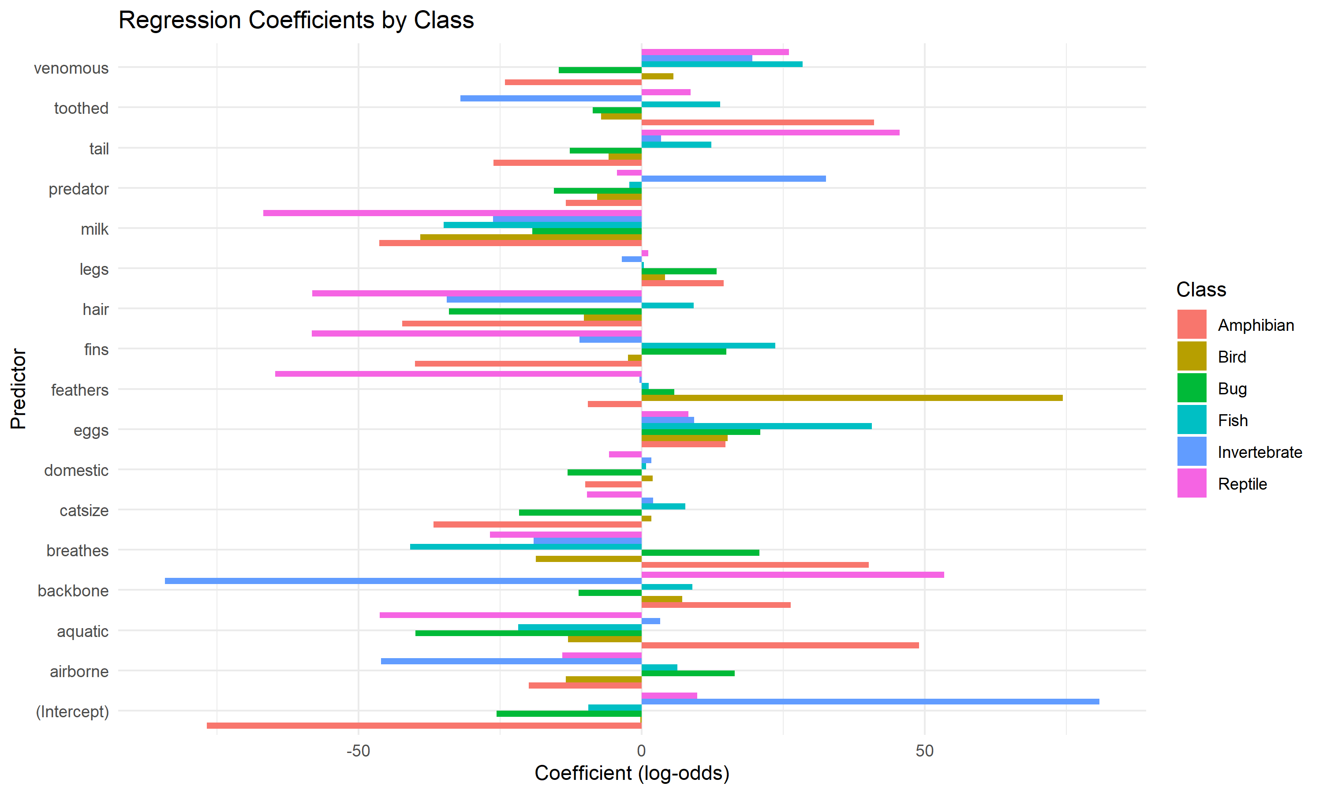
Log-Odds Bar Plot
Log-odds coefficients visualized across animal classes
Each color represents a different class:
  Mammals (red) indicate:
    Positive association with:
      Milk
      Hair
    Negative association with:
      Eggs
      Feathers
      Fins
  Birds (yellow) show:
    Strong positive association with:
      Feathers
    Positive association with:
      Eggs
      Being airborne
    Strong negative association with
      Milk
      Teeth

Slide 19
Log-Odds Bar Plot (Continued)
  Fish (green) are defined by:
    Strong positive association with:
      Fins
      Aquatic features
    Positive association with:
      Eggs
    Negative association with:
      Limbs
      Milk
      Airborne Features
  Amphibians (teal) show:
    Positive association with:
      Aquatic features
      Breathing features
    Moderate association with:
      Eggs
    Some association with:
      Toothed features
  Invertebrates (blue) demonstrate:​
      Strong negative association with:​
          Backbone​
      Negative association with:​
          Toothed features​
      Often have more legs than other classes​
  Reptiles (purple) illustrate:​
      Positive association with:​
          Backbone​
          Eggs​
          Venomous features​
      Moderate association with:​
          Toothed features​
      Negative association with​
          Milk​
          Feathers

Slide 20
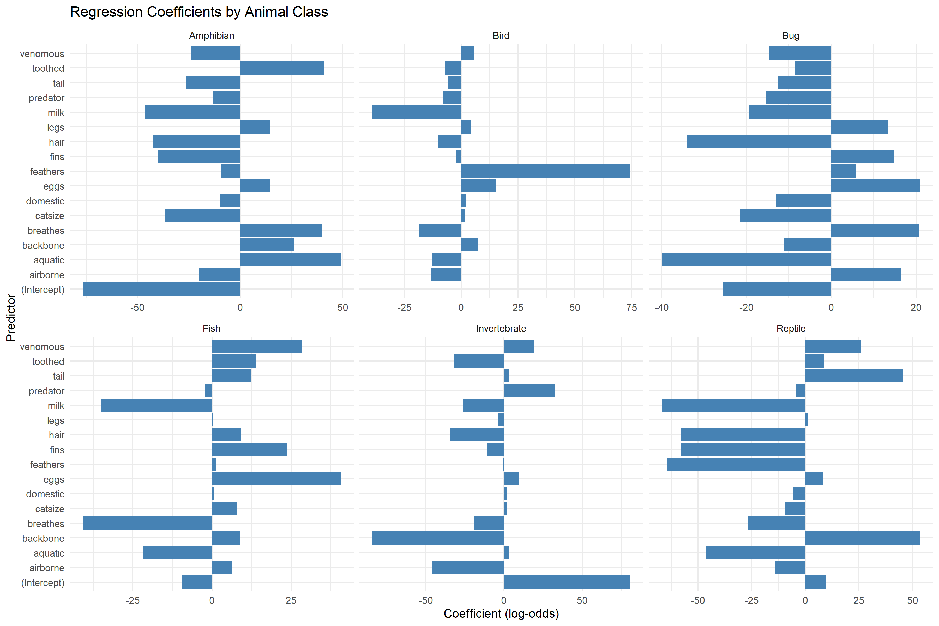
Log Odds Facet Plot
This visualization shows the same information as in the Log-Odds Bar Plot, but:
  Organized into separate panels for each class, allowing:
    Clearer comparison of feature significance within each class
Amphibians:
  Strong negative coefficients for:
    Hair
    Feathers
    Milk
  Positive for:
    Aquatic
    Predator

Slide 21
Log-Odds Facet Plot (Continued)
Fish
  Strong positive coefficients for:
    Fins
    Aquatic
  Negative coefficients for:
    Milk
    Legs
Birds
  Very high positive coefficient for:
    Feathers
  Positive coefficient for:
    Airborne
    Eggs
Invertebrates
  Extremely negative coefficient for:
    Backbone
  Positive coefficient for:
    Aquatic
Bugs
  High positive values for:
    Legs (6 legs)
    Airborne
  Strongly negative for:
    Backbone
Reptiles
  Strong positive coefficients for:
    Backbone
    Eggs
  Negative coefficients for:
    Milk

Slide 22
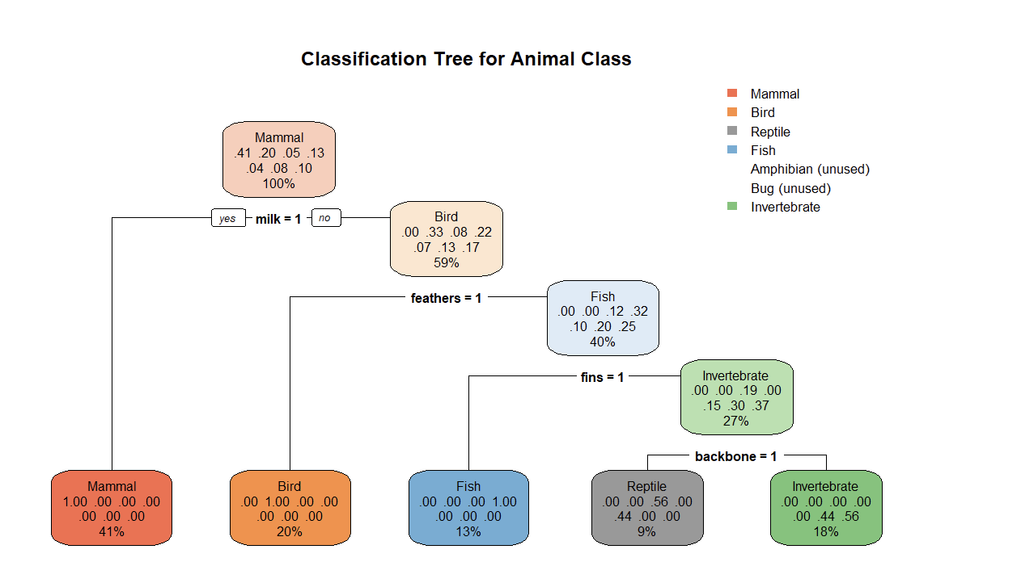
Classification tree
Visualization of how animals can be categorized:
  Using binary variables
Split on milk:
  Animals producing milk (yes):
    Classified as Mammals
For non-milk producing animals (no path):
  If they have feathers:
    Classified as Birds
  If no feathers but have fins:
    Classified as Fish
  If no fins but have a backbone:
    Classified as Reptiles
  If no backbone:
    Classified as Invertebrates

Slide 23
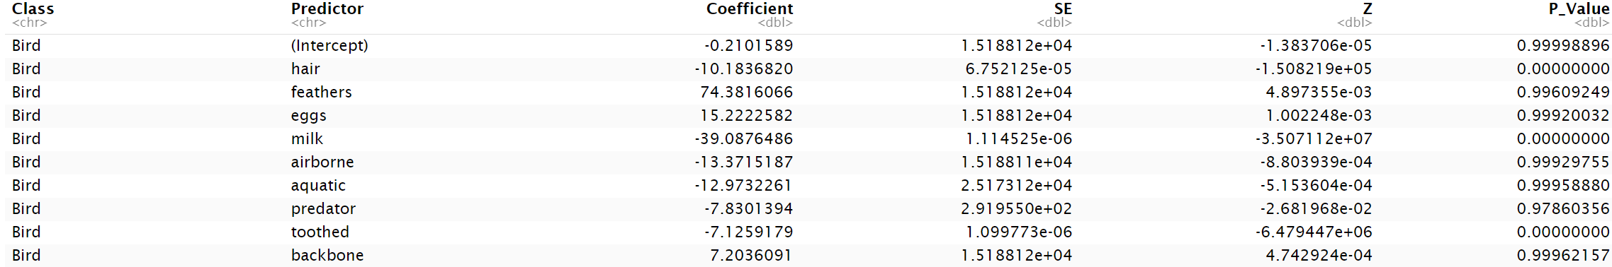
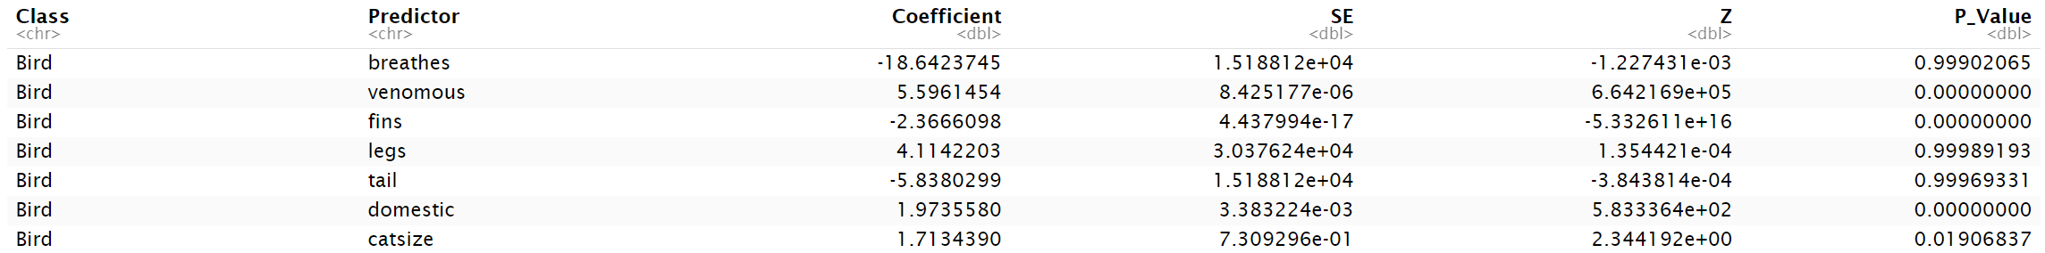
Significance of Predictors for Bird Classification
Some SEs are huge (e.g., 1.518812e+04), often a sign of: Separation issues, where some traits perfectly predict a class, Sparse data, or Multicollinearity.
Non-significant predictors (p > 0.05) include:
hair, milk, airborne, etc.
Large absolute z-values imply that the predictor is significantly different from 0. Example:
  venomous: z ≈ 664,216 — very large, suggests strong significance.
  hair: z ≈ -150,821 — also large in magnitude.

Slide 24
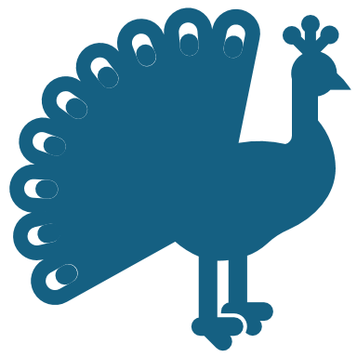
Interpretation of Results
Examples:
Traits show strong, logical associations with animal class
Presence of feathers strongly predicts Bird class
Presence of milk predicts Mammal class
Presence of fins predicts Fish class
Multinomial model successfully captures class distinctions
Practical Meaning:
  Traits provide reliable prediction of animal classes.

Slide 25

Key Takeaways
Strong patterns align with biological expectations
Class imbalance and multicollinearity addressed
Dataset and model appropriate for multinomial logistic regression

Slide 26
Appendix: List of Predictors
Hair
Feathers
Eggs
Milk
Airborne
Aquatic
Predator
Toothed
Backbone
Breathes
Venomous
Fins
Legs
Tail
Domestic
Cat Size

